Slide 1

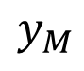
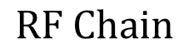
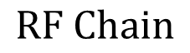
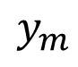
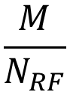
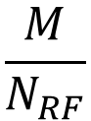
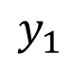
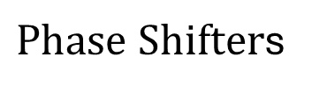

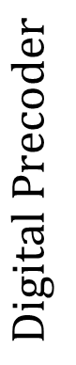
$Phase Shifter$s
$$\frac{M}{N_{RF}}$$
$$y_{1}$$
$$RF Chain$$
…
$$N_{RF}$$
$$\frac{M}{N_{RF}}$$
…
$$Digital Precoder$$
$$y_{m}$$
…
$$RF Chain$$
$$y_{M}$$

Slide 2
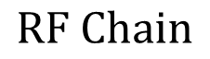
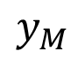
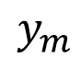
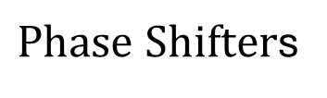
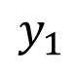
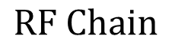
$Phase Shifter$s
$$y_{1}$$
$$RF Chain$$
$$y_{m}$$
…
$$Digital Precoder$$
$$RF Chain$$
$$y_{M}$$

Slide 3
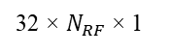
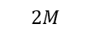
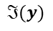
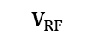
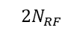
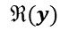
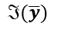
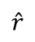
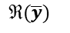
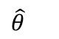
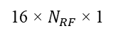
Analog Beamformer
Localizing Network
Conv-1
FC-3
Conv-2
FC-4
$$ℜ(y)$$
FC-5
$$ℜ(\overline{y})$$
Output
reshape
flatten
$$\hat{θ}$$
$$\hat{r}$$
$$ℑ(\overline{y})$$
2
$$ℑ(y)$$
$$2N_{RF}$$
16 × $N_{RF}$ × 1
128
256
$$2M$$
$$V_{RF}$$
32 × $N_{RF}$ × 1
512
Weight constraints
Convolutional Layer
Batch Norm + ReLU

Slide 4
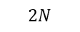
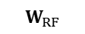
Analog Beamformer
Localizing Network
Conv-1
FC-3
Conv-2
FC-4
$$ℜ(y)$$
FC-5
$$ℜ(\overline{y})$$
Output
reshape
flatten
$$\hat{θ}$$
$$\hat{r}$$
$$ℑ(\overline{y})$$
2
$$ℑ(y)$$
$$2N_{RF}$$
16 × $N_{RF}$ × 1
128
256
$$2N$$
$$W_{RF}$$
32 × $N_{RF}$ × 1
512
Weight constraints as (8,9)
Convolutional Layer
Batch Norm + ReLU

Slide 5
RESULTS

Slide 6
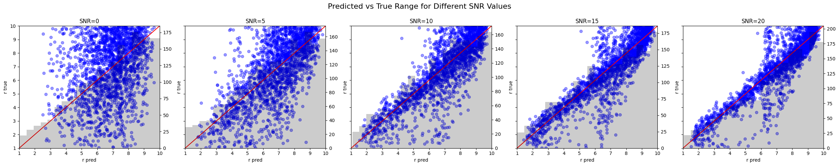
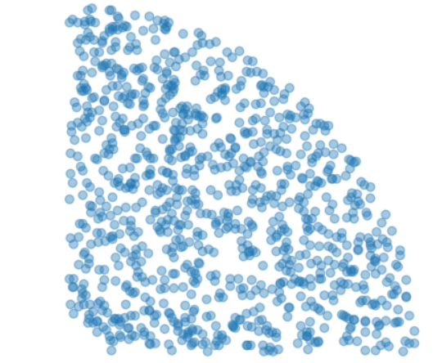
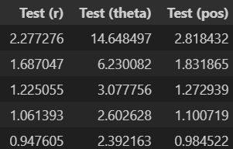
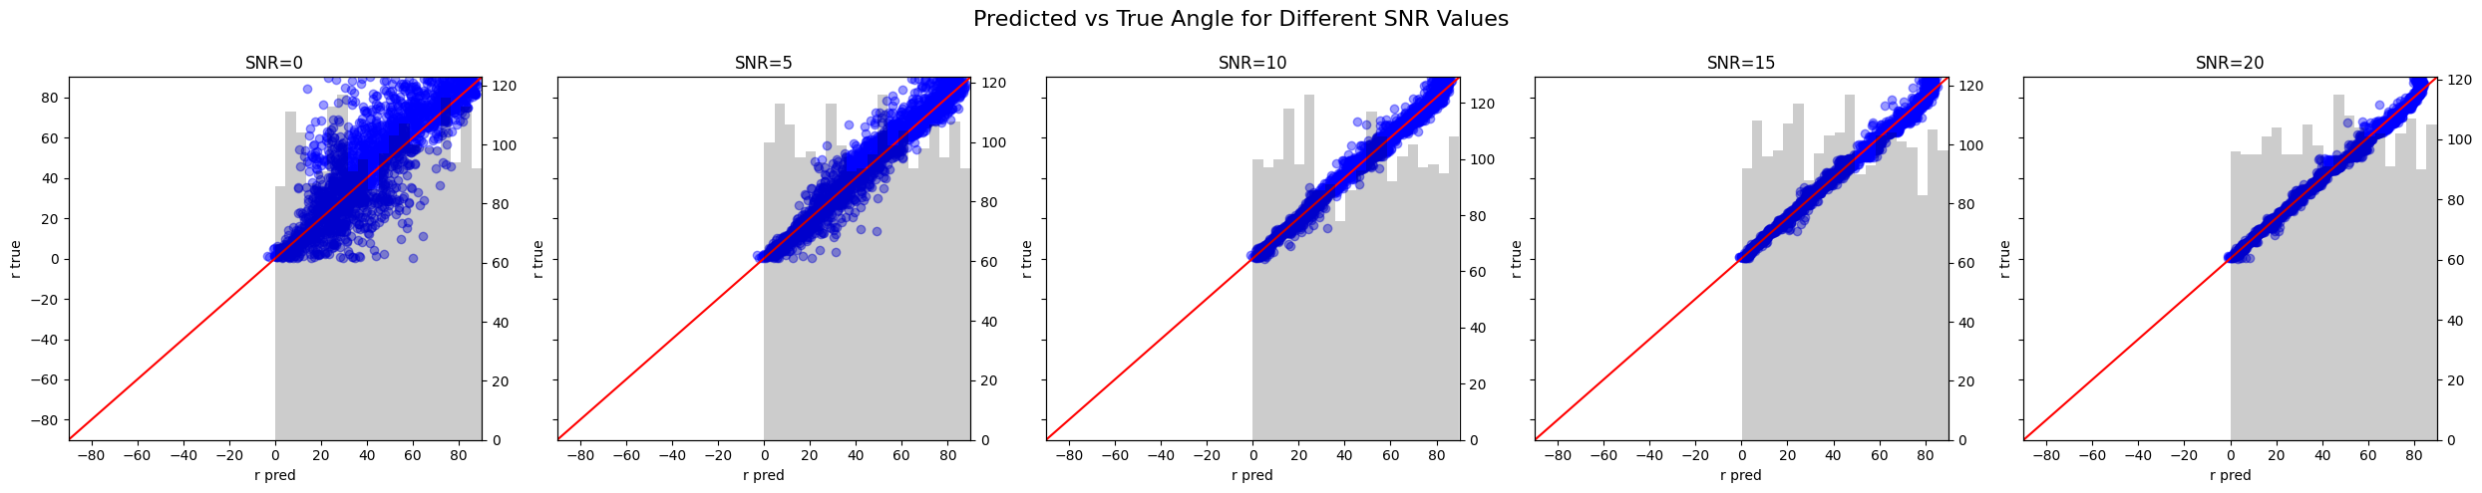
N=128, N_RF = 16
Range
Current paper results
Angle

Slide 7
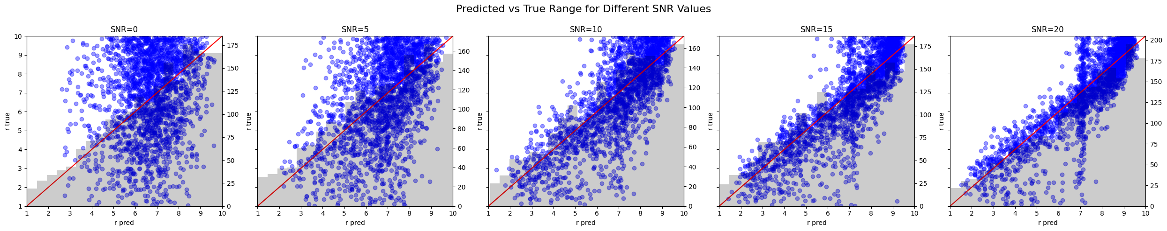
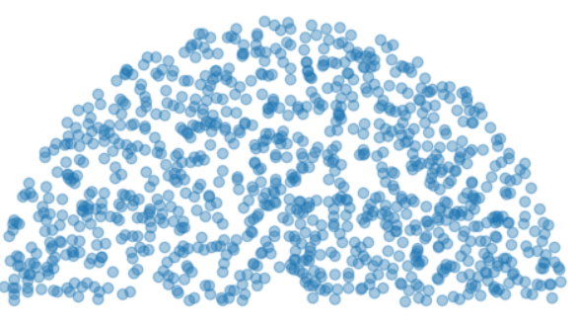
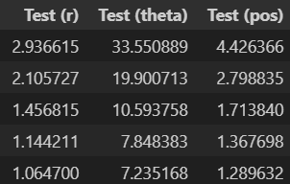
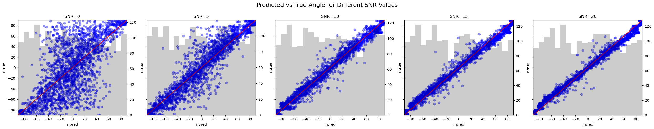
N=128, N_RF = 16
Range
Current paper results
Angle
Range
Angle

Slide 8
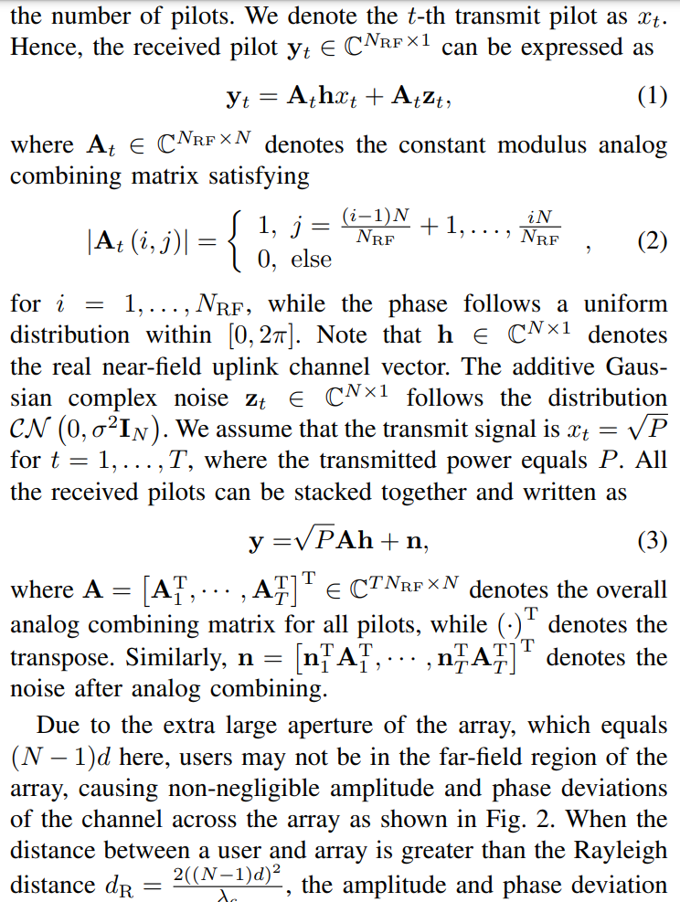

Slide 9
CNN

Slide 10
RESULTS - Multipath

Slide 11
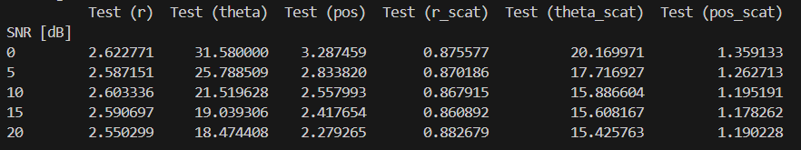
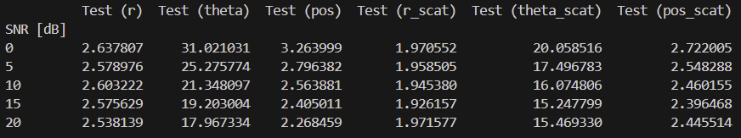
Posizione utente uniforme nell’area grigia.
Scatterer uniforme nell’area rossa.
Doveva essere 3x3 m^2 ma per sbaglio ho settato 3x6 m^2
Posizione utente uniforme nell’area grigia.
Scatterer uniforme nell’area rossa.
Doveva essere 3x3 m^2 ma per sbaglio ho settato 3x6 m^2
y
y
10m
10m
scatterer
5 m
user
3m x 6 m
3m x 6 m
1.5 m
1m
1.5 m
1m
4.5 m
4.5 m
ULA
x
x
ULA
Risultati
LoS
NLoS
LoS
NLoS

Slide 12
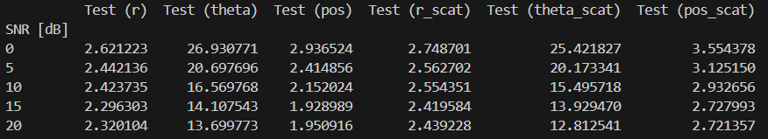
Posizione utente uniforme nell’area grigia.
Scatterer entro un raggio di 1.5m dall’utente
y
user
10m
scatterer
<1.5 m
1m
ULA
x
Risultati
LoS
NLoS

Slide 13
DNN old approach

Slide 14
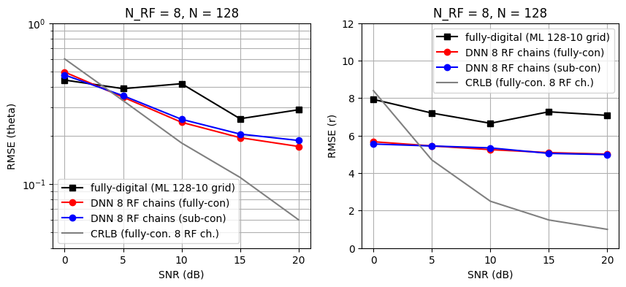
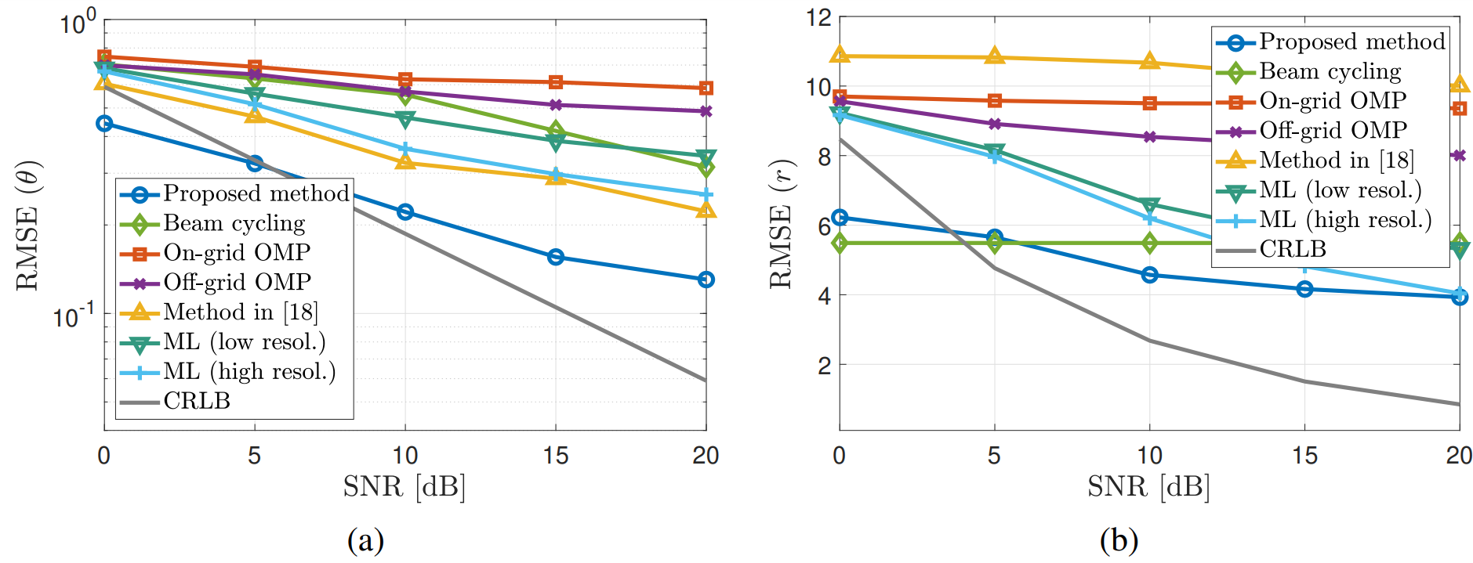
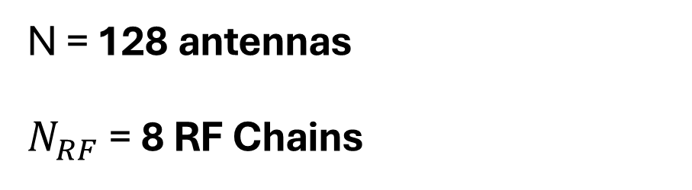
N = 128 antennas $N_{RF}$ = 8 RF Chains
Ours
Reference paper

Slide 15
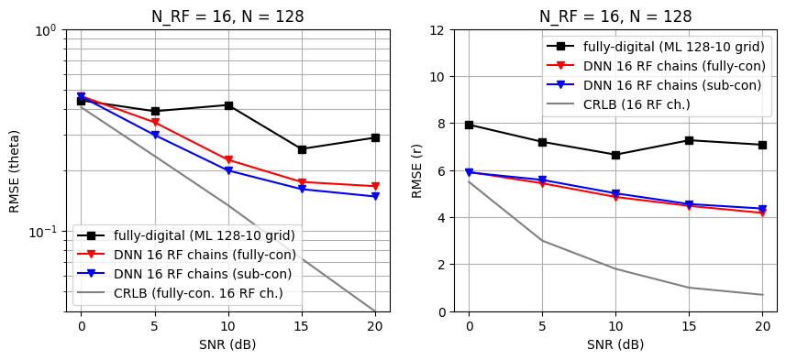
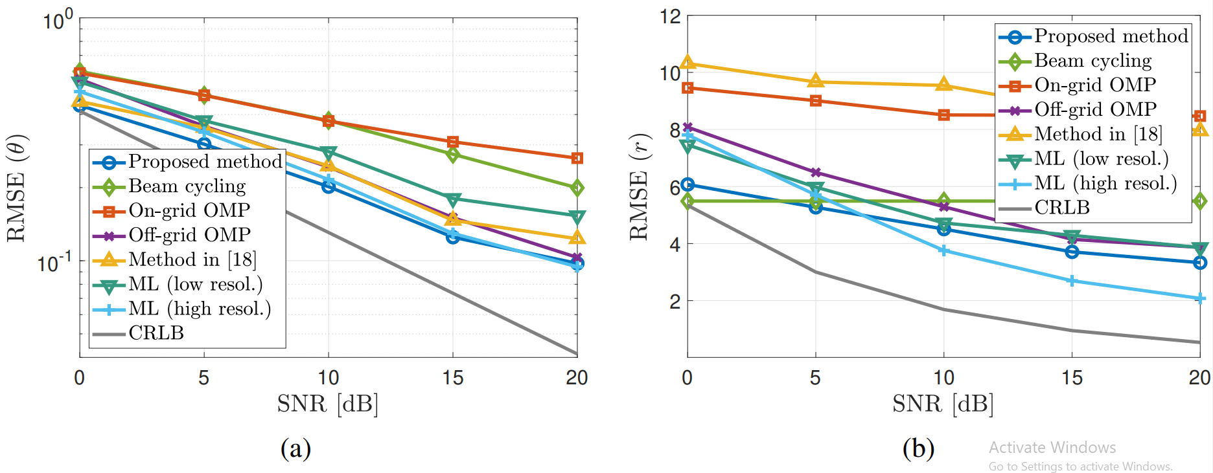
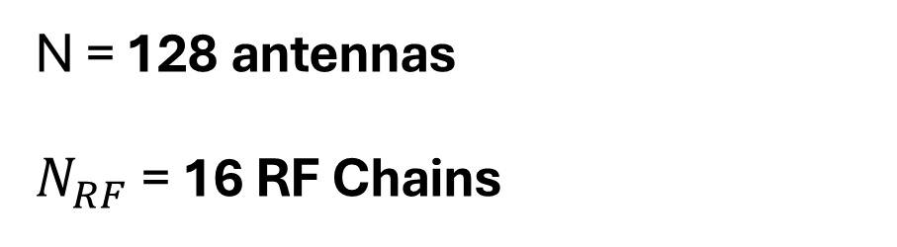
N = 128 antennas $N_{RF}$ = 16 RF Chains
Ours
Reference paper

Slide 16
PAPER FIGURES

Slide 17
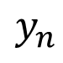
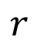
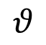
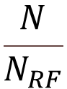





$$Phase Shifter$$
$$\frac{N}{N_{RF}}$$
$$y_{1}$$
$$RF Chain$$
…
…
$$θ$$
$$N_{RF}$$
$$\frac{N}{N_{RF}}$$
$$Digital Precoder$$
$$r$$
$$N$$
…
…
$$y_{n}$$
$$r_{n}$$
$$RF Chain$$
$$y_{N}$$

Slide 18


$$input layer$$

Slide 19




Hybrid Beamformer Structure
$W_{RF}$
$W_{RF}$
learned combining matrix
DNN 1st layer weights
$$j$$
Real Part
Imaginary
Part

Slide 20
$Phase Shifter$s
$$\frac{M}{N_{RF}}$$
$$y_{1}$$
$$RF Chain$$
…
$$N_{RF}$$
$$\frac{M}{N_{RF}}$$
…
$$Digital Precoder$$
$$y_{m}$$
…
$$RF Chain$$
$$y_{M}$$

Slide 21
$Phase Shifter$s
$$y_{1}$$
$$RF Chain$$
$$y_{m}$$
…
$$Digital Precoder$$
$$RF Chain$$
$$y_{M}$$

Slide 22


$Phase Shifter$s
$$\frac{N}{N_{RF}}$$
$$y_{1}$$
$$RF Chain$$
…
…
$$N_{RF}$$
$$\frac{N}{N_{RF}}$$
$$Digital Precoder$$
$$y_{n}$$
$$N_{RF}$$
…
…
$$RF Chain$$
$$y_{N}$$

Slide 23



$Phase Shifter$s
$$y_{1}$$
$$RF Chain$$
…
$$y_{n}$$
$$Digital Precoder$$
$$N_{RF}$$
…
$$RF Chain$$
$$y_{N}$$

Slide 24

$$Phase Shifter$$
$$\frac{N}{N_{RF}}$$
$$y_{1}$$
$$RF Chain$$
$$scatterer$$
…
…
$$N_{RF}$$
$$\frac{N}{N_{RF}}$$
$$Digital Precoder$$
$$y_{n}$$
$$N_{RF}$$
…
…
$$RF Chain$$
$$y_{N}$$

Slide 25


Hybrid Beamformer Structure
$$W_{RF}$$
learned combining matrix
DNN 1st layer weights
Real Part
$$j$$
Imaginary
Part

Slide 26








DNN
DNN
Beamformer
Localizing Function
Beamformer
Localizing Function
Real Part
Real Part
Re
Re
Im
Im
$$2$$
$$2$$
Imaginary Part
Imaginary Part
$$2N_{RF}$$
$$2N_{RF}$$
$$128 128 128$$
$$2N$$
$$2N$$
$$256 256 256$$
Before
After

Slide 27












DNN Structure
Beamformer
Localizing Function
Beamformer
Localizing Function
Real Part
Real Part
Re
Re
$$\hat{θ}$$
$$\hat{θ}$$
Hidden Layer 1
Hidden Layer 2
Hidden Layer 3
Hidden Layer 1
Hidden Layer 2
$$\hat{r}$$
Hidden Layer 3
$$\hat{r}$$
Im
Im
$$2$$
$$2$$
Imaginary Part
Imaginary Part
$$2N_{RF}$$
$$2N_{RF}$$
$$2N$$
$$256 256 256$$
$$2N$$
$$512 256 128$$

Slide 28








DNN Training vs Deployment
Analog
Beamformer
Localizing Function
Analog
Beamformer
Localizing Function
Real Part
$$ℜ(y)$$
Real Part
Re
Re
$$\hat{θ}$$
$$\hat{θ}$$
Hidden Layer 1
Hidden Layer 2
Hidden Layer 3
Hidden Layer 1
Hidden Layer 2
$$\hat{r}$$
Hidden Layer 3
$$\hat{r}$$
Im
Im
$$2$$
$$2$$
Imaginary Part
$$ℑ(y)$$
Imaginary Part
$$2N_{RF}$$
$$2N_{RF}$$
$$2N$$
$$256 256 256$$
$$2N$$
$$512 256 128$$

Slide 29





















4
$${ N}_{RF}$$
$$1$$
Analog
Beamformer
Localizing Function
Analog
Beamformer
Localizing Function
$$filter size:(1,1)$$
$$ℜ(y)$$
Real Part
$$ℜ(y)$$
Real Part
Re
Re
$$conv layer$$
Hidden Layer 1
$$\hat{θ}$$
Mod(),
Phase()
Hidden Layer
$$\hat{θ}$$
Hidden Layer 2
flatten
Hidden Layer
Hidden Layer 3
$$\hat{r}$$
Im
$$\hat{r}$$
Im
$$ℑ(y)$$
Imaginary Part
$$2$$
$$ℑ(y)$$
Imaginary Part
2 x${ N}_{RF}\text{x}1$
$$2$$
$$2N_{RF}$$
$$2N_{RF}$$
64 x${ N}_{RF}\text{x}1$
$$256 128$$
$$2N$$
$$512 256 128$$
$$2N$$
$$channels x height x width$$

Slide 30







Analog Beamformer
Localizing Function
Conv-1
FC-3
Conv-2
FC-4
$$ℜ(y)$$
FC-5
$$ℜ(\overline{y})$$
Output
reshape
flatten
$$\hat{θ}$$
$$\hat{r}$$
$$ℑ(\overline{y})$$
2
$$ℑ(y)$$
$$2N_{RF}$$
4 × 2 × 16
128
256
$$2N$$
$2N_{RF}$ × 2 × 4
512
Weight constraints as (5)
Convolutional Layer
Batch Norm + ReLU
PRIMA
DOPO

Slide 31

















Analog
Beamformer
Localizing Function
$$filter size:(1,1)$$
$$ℜ(y)$$
Real Part
Re
$$conv layer$$
Mod(),
Phase()
Hidden Layer
$$\hat{θ}$$
flatten
Hidden Layer
Im
$$\hat{r}$$
$$ℑ(y)$$
Imaginary Part
2 x${ N}_{RF}\text{x}1$
$$2$$
$$2N_{RF}$$
64 x${ N}_{RF}\text{x}1$
$$256 128$$
$$2N$$
$$channels x height x width$$
Analog Beamformer
Localizing Function
Conv-1
FC-3
Conv-2
FC-4
$$ℜ(y)$$
FC-5
$$ℜ(\overline{y})$$
Output
reshape
flatten
$$\hat{θ}$$
$$\hat{r}$$
$$ℑ(\overline{y})$$
2
$$ℑ(y)$$
$$2N_{RF}$$
16 × $N_{RF}$ × 1
128
256
$$2N$$
4 × $N_{RF}$ × 1
512
Weight constraints as (5)
Convolutional Layer
Batch Norm + ReLU

Slide 32
MAXIMUM LIKELIHOOD EXAMPLES

Slide 33




Grid
(angle,range)= (180,40)

Slide 34




Grid
(angle,range)= (128,10)

Slide 35


Slide 36










Slide 37












$$y_{1}$$
$$\frac{N}{N_{RF}}$$
$$RF Chain$$
…
…
$$θ$$
$$N_{RF}$$
$$Digital Precoder$$
$$r$$
$$N$$
…
$$y_{n}$$
…
$$r_{n}$$
$$y_{N}$$

Slide 38

Training per stimare (theta,r,theta_scat,r_scat)
Settando 0.5 come Potenza del segnale scatterato non funziona, peggiora il training (non è neanche realistico)
SNR = (0,5,10,15,20)

Slide 39

SNR = (15,20,25,30)

